Slide 1

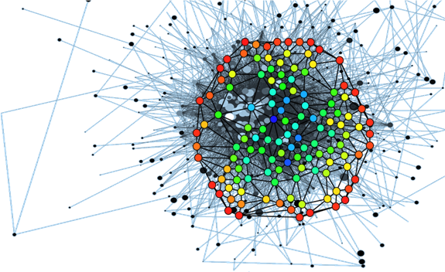
Reduction of trajectory search time in functional MRI data
Marcelo Pinto
Rogério Moreira

Slide 2
The problem
Functional connectivity in the brain can be observed using resting-state functional magnetic resonance imaging (FMRI);
However, brain function is mediated by many functionaly distinct networks;
These networks may overlap each other;
There is no functional trajectory search software yet, there are only functional point-to-point connectivity;
The main problem is the time required for this type of software;

Slide 3
The goal
We want a network model that allows overlap of networks;
We want a solution that will solve this problem in usefull time.
Aqui talvez seja bom explicar com uma imagem o porquê de demorar bastante tempo (explicando para N=2 e depois o que nós pretendemos)

Slide 4
Task List:
- Understand the data (visualization, structure, access, type); (Done)
- Understand the processing (applications, example in some cases); (Done)
- Understand the problem (...); (Done)
- Understand the solution proposed by Nicolas Lori; (Current State)
- Implement the proposed solution;
- Evaluate the results and finalize the report;

Slide 5
Functional magnetic resonance imaging
Para apagar certo?
Measures brain activity by detecting changes associated with blood flow;
This technique relies on the fact that cerebral blood flow and neuronal activation are coupled. When an area of the brain is in use, blood flow to that region also increases.

Slide 6
seeD-BASED CORRELATION
Para apagar certo?
Temporal correlation is treated as a single fixed quantity to be estimated over the whole experiment’s duration;

Slide 7
Spacial Independent component analysis (spacial ICA)
Para apagar certo?
Spacial ICA decomposes the data into components that are maximally spatially independent of each other;

Slide 8
Temporal ICA
Para apagar certo?

